Slide 1

WAY TO ENTERPRISE
AWS
VTI ACADEMY
Author: duy.nguyenngoc1@vti.com.vn

Slide 2
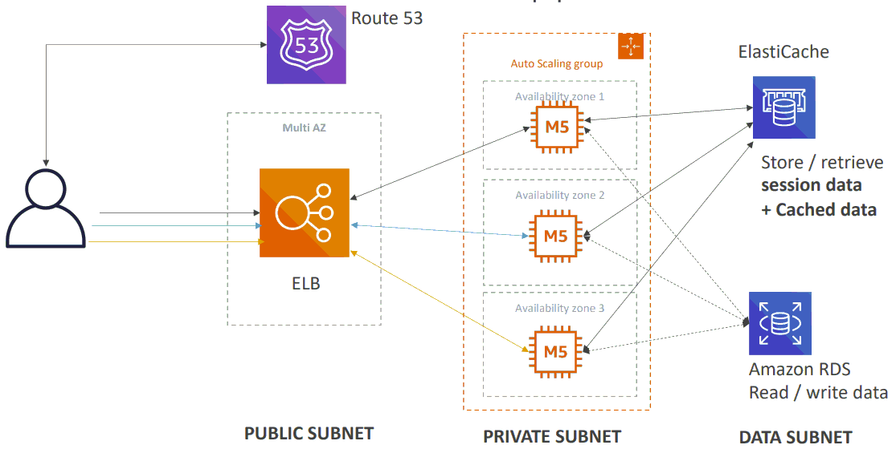
Developer problems on AWS
Managing infrastructure
Deploying Code
Configuring all the databases, load balancers, ...
Scaling concerns
Most web apps have the same architecture (ALB + ASG)
All the developers want is for their code to run!
Possibly, consistently across different applications and environments
Typical architecture: Web App 3-tier

Slide 3
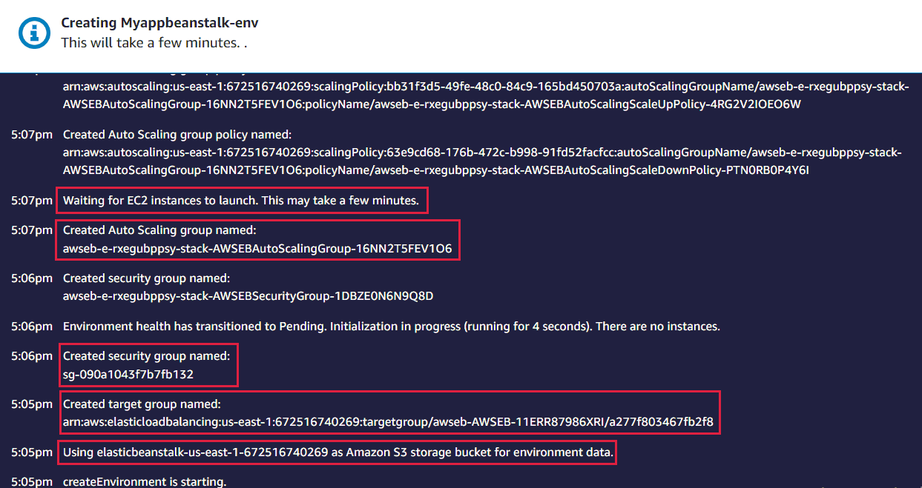
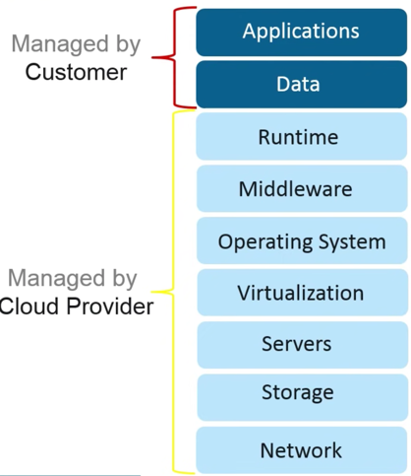
Beanstalk
Elastic Beanstalk is a developer centric view of deploying an application on AWS
You just upload the application, then beanstalk will automatically setup EC2, Auto scaling ELB, capacity, health monitoring, security group, ... no need to care about security group, no need to ssh into EC2 and install software, setup CloudWatch, ...
We still have full control over the configuration (custom configuration)
AWS will automatically initialize the resource according to config

Slide 4
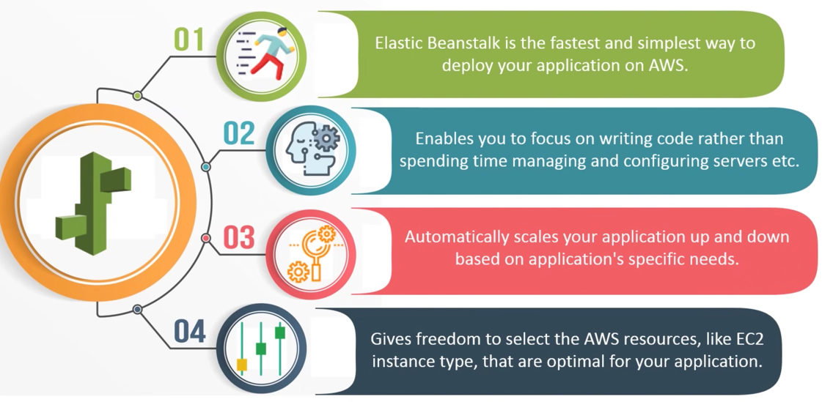
Beanstalk
Highly scalable
Fast and simple to begin
Quick deployment
Support multi-tenant architecture
Support .NET, Java, Node.js, PHP, Python, Go, Docker, …
Price: Free - https://aws.amazon.com/elasticbeanstalk
Tutorial: https://docs.aws.amazon.com/elasticbeanstalk/latest/dg/Welcome.html

Slide 5
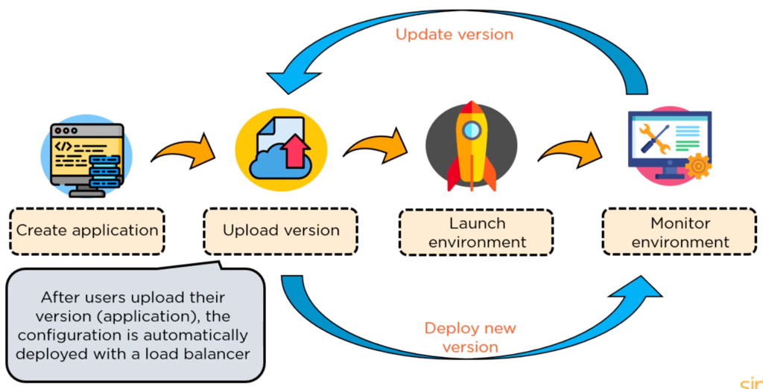
Beanstalk
Flow

Slide 6
Beanstalk
Demo
  Create Beanstalk Application
  Test

Slide 7
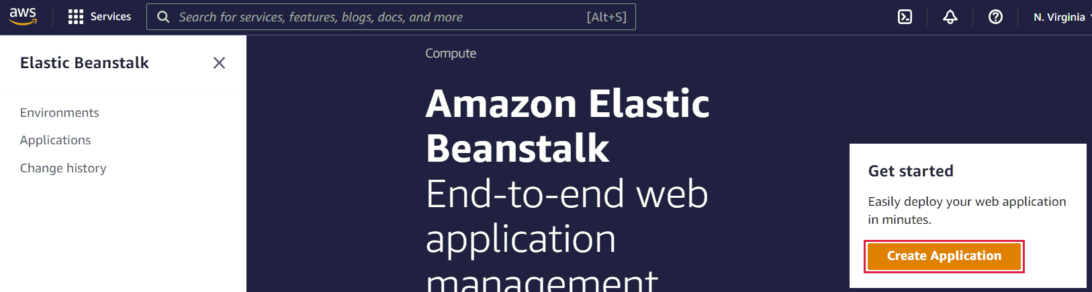
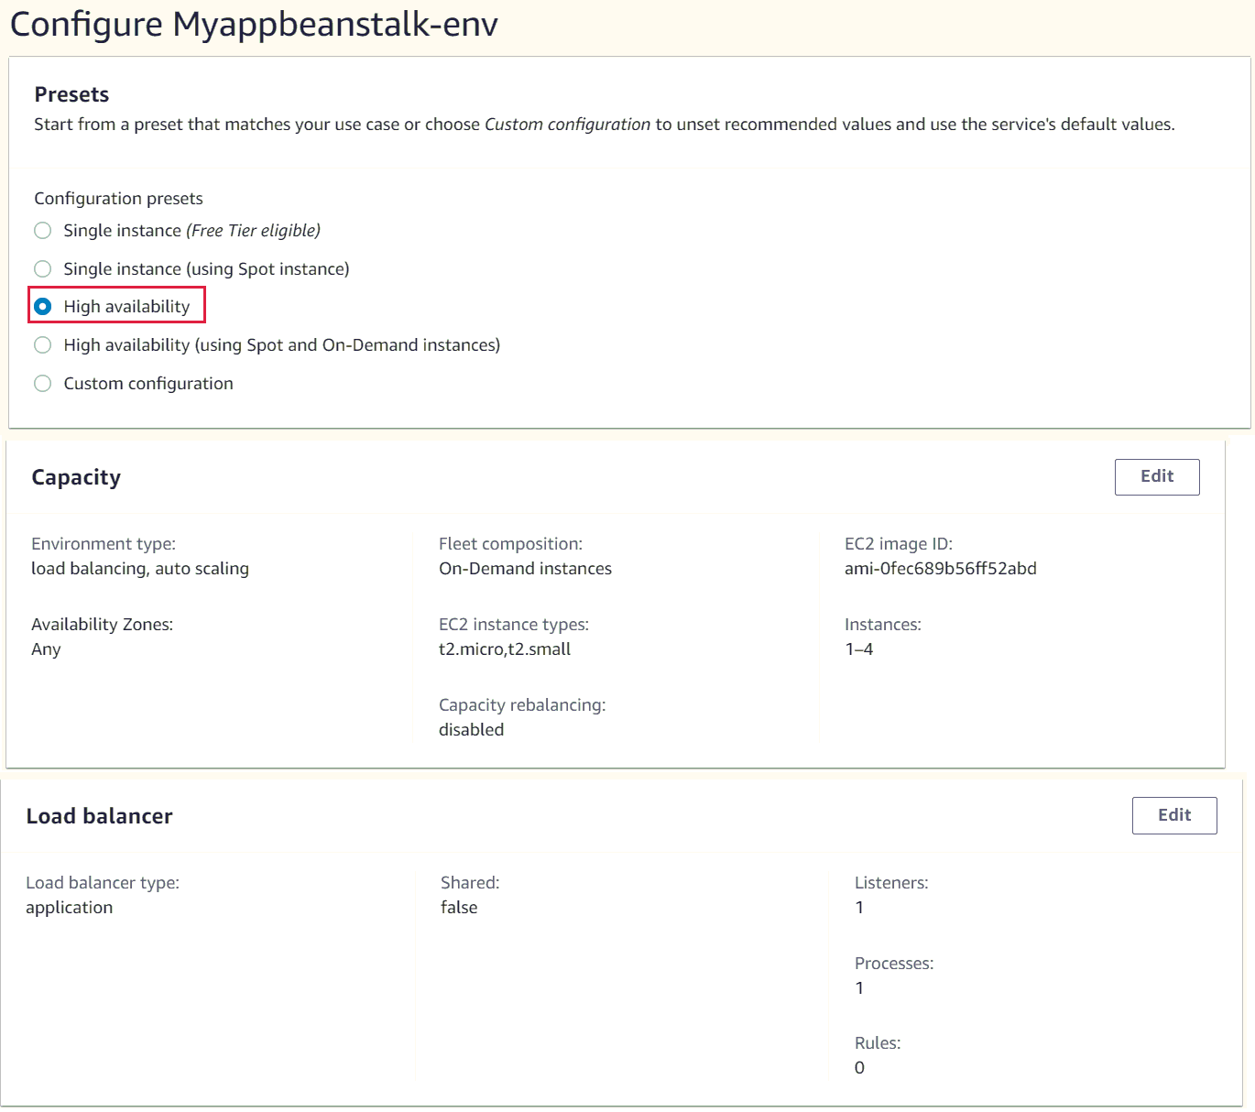
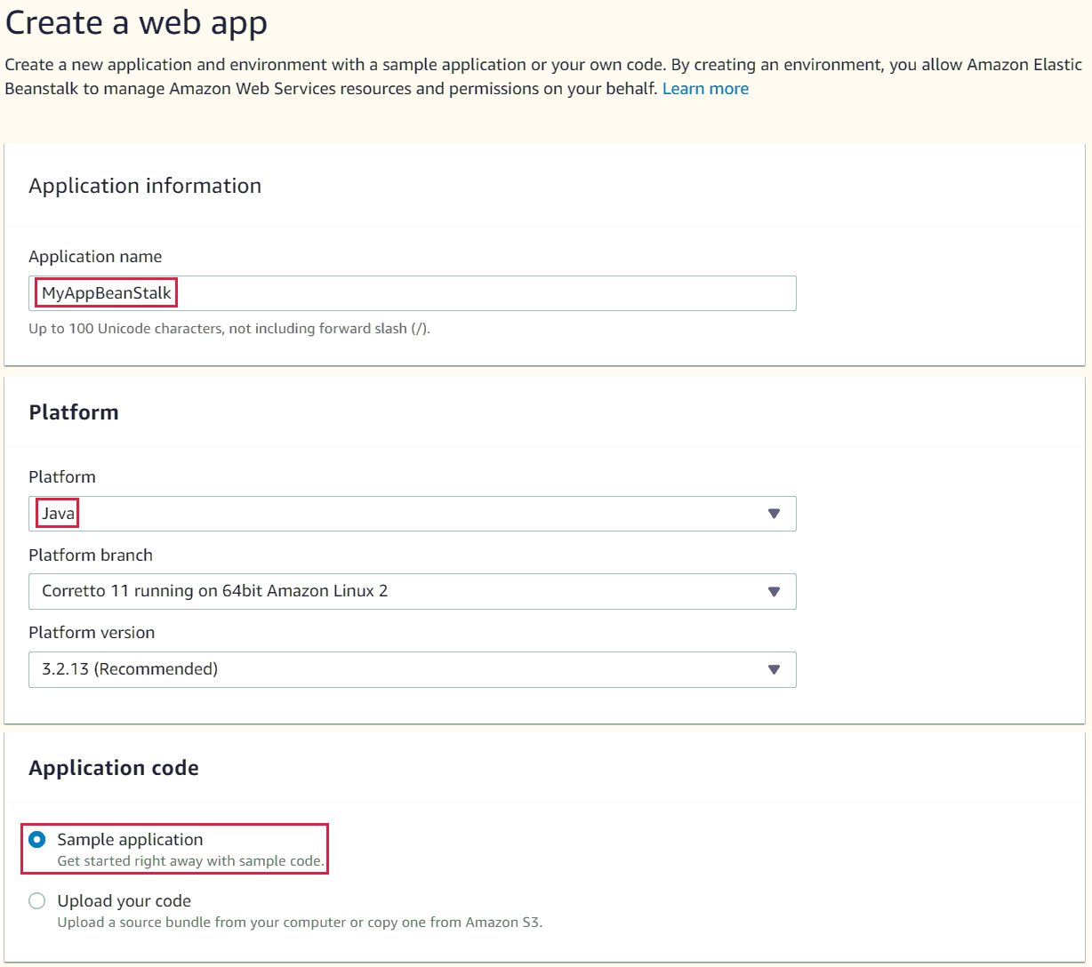
Beanstalk
  Create Beanstalk Application

Slide 8
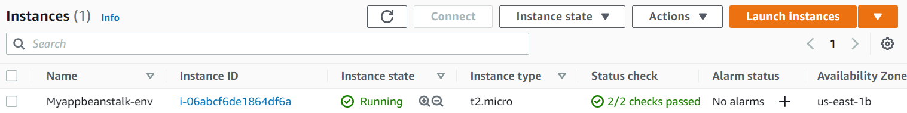
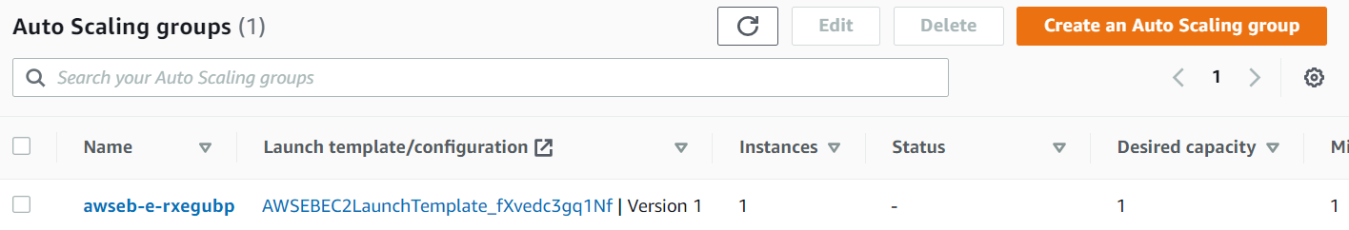
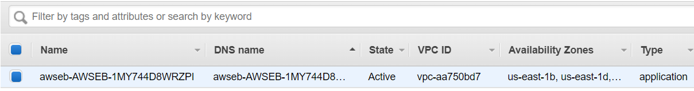
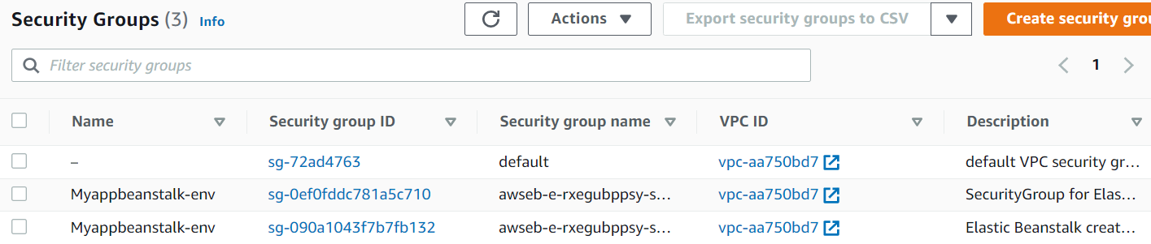
Beanstalk
EC2
Auto Scaling
ELB
AWS will automatically initialize the resource according to config
Security Group

Slide 9
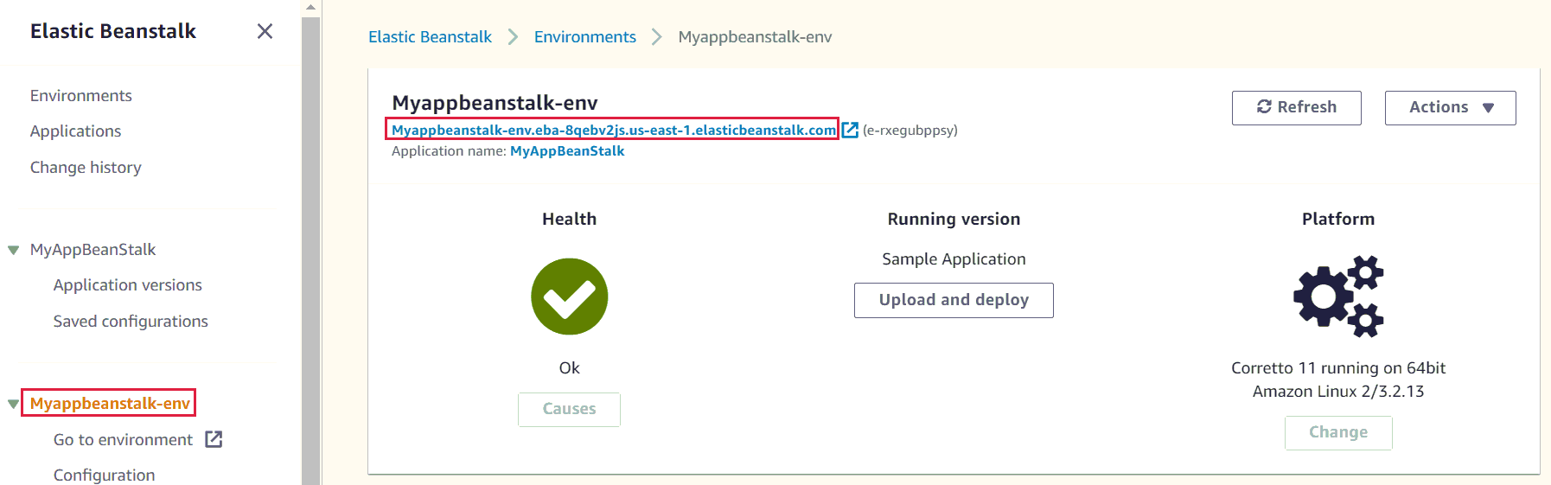
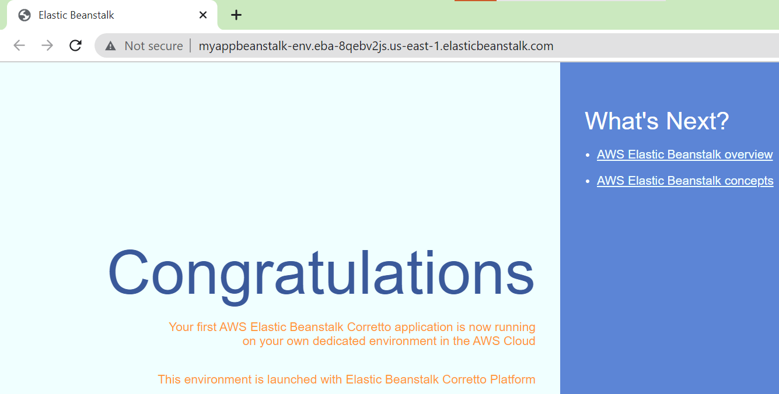
Beanstalk
  Test

Slide 10
Assignment
  Self-practice

Slide 11
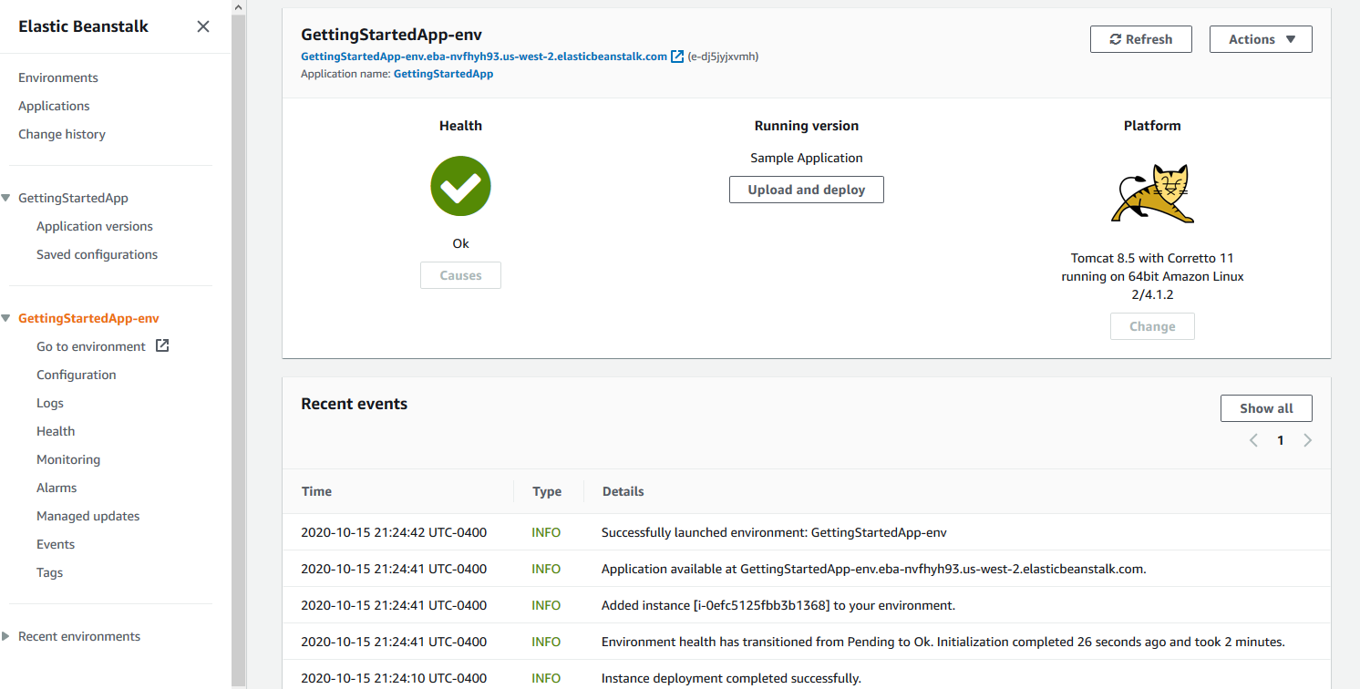
Beanstalk
Components
  Application
  Environment

Slide 12
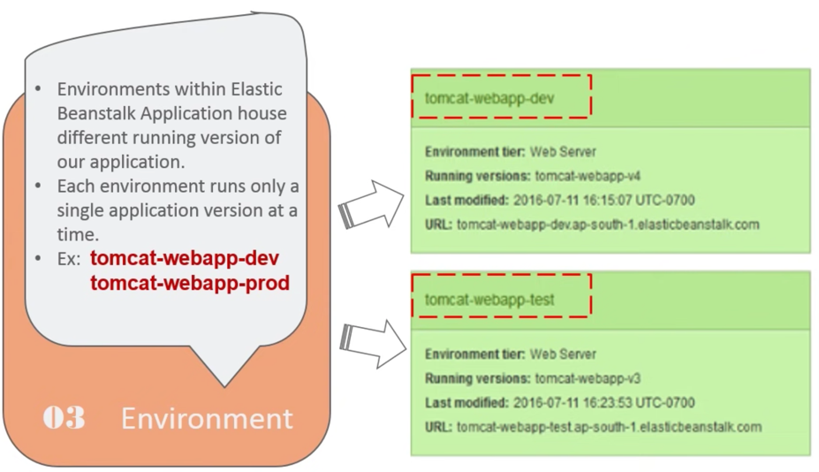
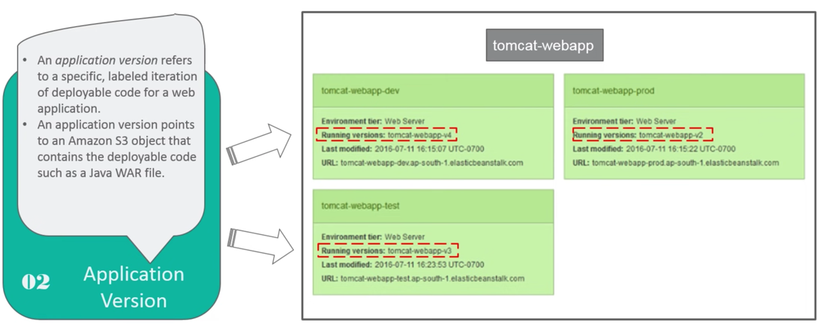
Beanstalk
  Application:
    Collection of Elastic Beanstalk components (environments, versions, configurations, …)
Environment
Version
(When you upload a new version, AWS will automatically change the resource)

Slide 13
Beanstalk
  Environment
    Collection of AWS resources running an application version (only one application version at a time)
    You can create multiple environments (dev, test, prod, …)
    Support versioning feature
    2 types: Web Server Environment, Worker Environment
      Web Server Environment: using for applications accessed through port 80, HTTP
      Worker Environment: using for applications running in the background, calling the application through SQS, when finished, will post messages to other applications via HTTP (Ex: email notification, generate report, clean up database, ...)

Slide 14
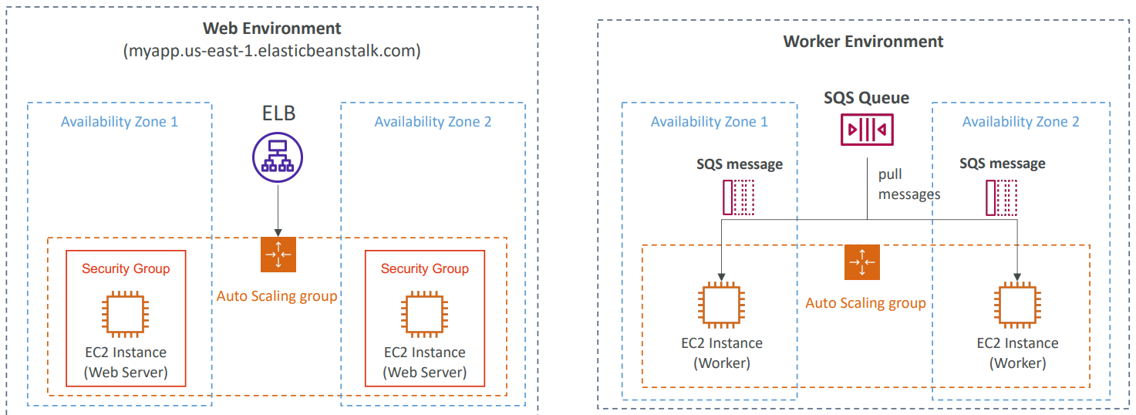
Beanstalk

Slide 15
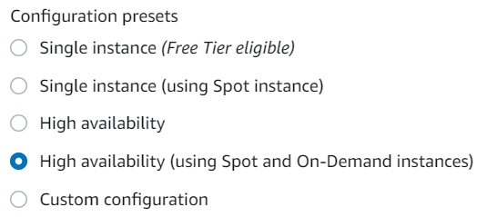
Beanstalk
    Including
      Platform (.NET, Java, Node.js, PHP, Python, Go, Docker, …)
      EC2 instance (Support High Availability, spot, on-demand instance), Security Group
      VPC, Database
      Autoscaling, Load balancer, Checking EC2 Health, CloudWatch Alarm
      Monitoring & Log
      Notification
      Domain

Slide 16
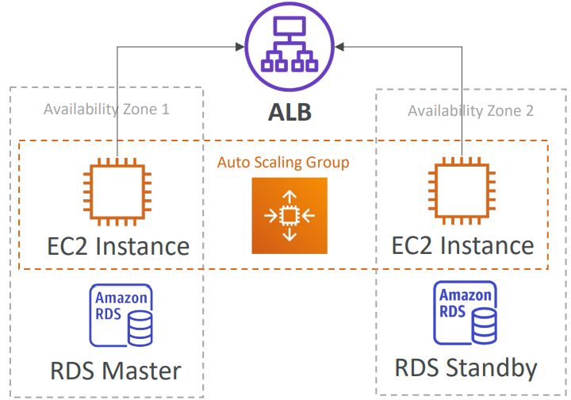
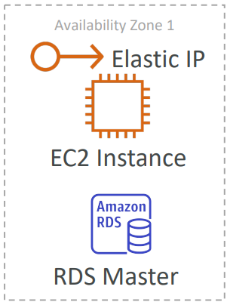
Beanstalk
Deployment
Single Instances
High Availability

Slide 17
Assignment
  Self-practice

Slide 18
Summary
Elastic Beanstalk is a developer centric view of deploying an application on AWS
You just upload the application, then beanstalk will automatically setup EC2, Auto scaling ELB, capacity, health monitoring, security group, ...
Components
  Application: collection of Elastic Beanstalk components (environments, versions, configurations, …)
  Environment: 2 types - Web Server Environment, Worker Environment

Slide 19
Q & A
Copyright © VTI Academy All Rights Reserved

